Slide 1
Hamburger Paragraphs
How to write a really
great paragraph!

Slide 2
What is a paragraph?
A paragraph is a group of closely related sentences developing ONE topic.
Notes:
The "paragraph hamburger" is a writing organizer that visually outlines the key components of a paragraph. Topic sentence, detail sentences, and a closing sentence are the main elements of a good paragraph, and each one forms a different "piece" of the hamburger.

Slide 3
What does a paragraph look like?
A paragraph is made up of at least 5 sentences. Every paragraph has 3 main parts:
INTRODUCTION: includes the topic sentence, must be specific and clear
BODY: supports the topic sentence, adds to and develops the main idea, explains the topic, includes details, examples, incidents, causes, effects
CONCLUSION: closes off or sums up the ideas, it must refer back to the opening without repeating the opening words

Slide 4
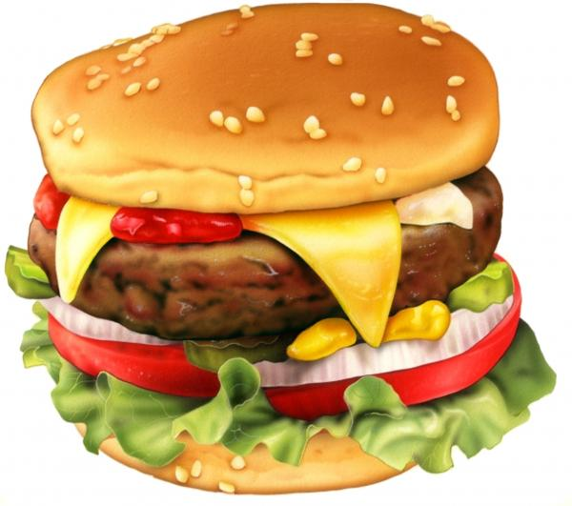
The Hamburger Paragraph
Introduction
1.__________________________
Examples/Proof
Body
2. _____________________
3. ___________________________
Description
4. _____________________
5. ______________________________
Conclusion
Notes:
Writing the Hamburger Paragraph — Presentation Transcript
1. Writing the Hamburger Paragraph
2. The Three-Patty Hamburger Paragraph Top bun: topic sentence Patty: information Cheese: more detail Patty: information Cheese: more detail Patty: information Cheese: more detail Bottom burger bun (BBB): top bun restated differently
3. The Hamburger Paragraph (a four-patty example) Writing a hamburger paragraph is pretty easy, and there are only four things you really need to remember. First, write a topic sentence that clearly indicates what the whole paragraph is going to be about. This is the top bun of the burger. Second, compose several sentences that give information about the topic. These are the real meat of the thing—the most important part of a burger. Third, pair each patty with another sentence that gives more detail about the information. This keeps your paragraph from sounding like a list. Finally, write a sentence in which you restate the top bun in another way. I call this the bottom burger bun. As you can see, writing a hamburger paragraph is very simple to do. Top Bun Information More detail Information More detail Information More detail Information More detail BBB
4. Bottom Burger Bun Starters As you can see, As I&apos;ve shown you, It should be clear by now that Obviously, Without any doubt, Clearly, It should now come as no surprise that
5. Choose one and write it Write a three-patty hamburger paragraph about three fun things to do during a sleepover. Write a three-patty hamburger paragraph about three things you like about yourself. Write a three-patty hamburger paragraph about three qualities that make a good friend.
6. Your assignment Write a three-patty hamburger paragraph about three ways that geography has affected the life in Japan. Address these topics: The ocean The ring of fire The mountains
7. fin

Slide 5
Example 1:
I do not like tests. Every time I take a test, I feel nervous. When I study for a test, I don’t know if I will be able to get a good grade. I worry a lot about the test, so I cant sleep. After the test is over , I worry about my grade. When my teacher gives me my grade, I cant relax because I know I will have another test soon. I wish tests never existed.

Slide 6
Example 2:
Winter is my favourite season. During the long Canadian winters, I can wear a big coat and my favourite sweater. When it’s cold, I can eat hot foods and drink hot chocolate too. Best of all, in the winter I can do a lot of activities. I can play in the snow, make snowmen and snow angels. I can go skiing, ice skating, or stay at home by the fireplace. Winter should be all year long.

Slide 7
Writing Tips
Always capitalize names of people, cities, towns and countries
First word in a sentence should ALWAYS have a Capital
Do not use “texting” lingo, you must write out the whole word
The word I is always capitalized when using as a personal pronoun
Notes:
1. Writing the Hamburger Paragraph
2. The Three-Patty Hamburger Paragraph Top bun: topic sentence Patty: information Cheese: more detail Patty: information Cheese: more detail Patty: information Cheese: more detail Bottom burger bun (BBB): top bun restated differently
3. The Hamburger Paragraph (a four-patty example) Writing a hamburger paragraph is pretty easy, and there are only four things you really need to remember. First, write a topic sentence that clearly indicates what the whole paragraph is going to be about. This is the top bun of the burger. Second, compose several sentences that give information about the topic. These are the real meat of the thing—the most important part of a burger. Third, pair each patty with another sentence that gives more detail about the information. This keeps your paragraph from sounding like a list. Finally, write a sentence in which you restate the top bun in another way. I call this the bottom burger bun. As you can see, writing a hamburger paragraph is very simple to do. Top Bun Information More detail Information More detail Information More detail Information More detail BBB
4. Bottom Burger Bun Starters As you can see, As I&apos;ve shown you, It should be clear by now that Obviously, Without any doubt, Clearly, It should now come as no surprise that
5. Choose one and write it Write a three-patty hamburger paragraph about three fun things to do during a sleepover. Write a three-patty hamburger paragraph about three things you like about yourself. Write a three-patty hamburger paragraph about three qualities that make a good friend.
6. Your assignment Write a three-patty hamburger paragraph about three ways that geography has affected the life in Japan. Address these topics: The ocean The ring of fire The mountains
7. fin

Slide 8
The Topic Sentence (Top Bun)
Very first sentence of your paragraph.
Always needs to be indented.
Tells what your paragraph is going to be about.
There are many reasons that I love to teach. First of all, I love to teach because I love being at school. Another reason I love teaching is that the days go by quickly. A third reason I love to teach is because I love seeing a student understand something new. Finally, I love to teach because I love to be around kids. These are just a few reasons I love to teach.
Click here to return to the hamburger

Slide 9
The First Detail (Lettuce)
There are many reasons that I love to teach. First of all, I love to teach because I love being at school. Another reason I love teaching is that the days go by quickly. A third reason I love to teach is because I love seeing a student understand something new. Finally, I love to teach because I love to be around kids. These are just a few reasons I love to teach.
Should not be the most important detail.
Needs to follow directly after the topic sentence.
Needs to be full of good “lettucy” details!
Click here to return to the hamburger

Slide 10
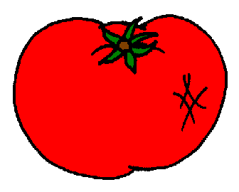
The Second Detail (Tomato)
There are many reasons that I love to teach. First of all, I love to teach because I love being at school. Another reason I love teaching is that the days go by quickly. A third reason I love to teach is because I love seeing a student understand something new. Finally, I love to teach because I love to be around kids. These are just a few reasons I love to teach.
Still should not be the most important detail.
Needs to follow directly after the lettuce sentence.
Needs to be full of good “juicy” details!
Click here to return to the hamburger

Slide 11
The Third Detail (Cheese)
There are many reasons that I love to teach. First of all, I love to teach because I love being at school. Another reason I love teaching is that the days go by quickly. A third reason I love to teach is because I love seeing a student understand something new. Finally, I love to teach because I love to be around kids. These are just a few reasons I love to teach.
Still not be the most important detail.
Needs to start differently than other sentences.
Needs to be full of good “cheesy” details!
Click here to return to the hamburger

Slide 12
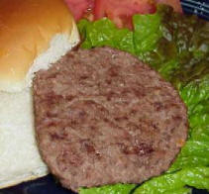
The Last Detail (Meat)
There are many reasons that I love to teach. First of all, I love to teach because I love being at school. Another reason I love teaching is that the days go by quickly. A third reason I love to teach is because I love seeing a student understand something new. Finally, I love to teach because I love to be around kids. These are just a few reasons I love to teach.
Finally!! The most important detail.
Should start differently than most of the other sentences.
Needs to be full of good “meaty” details!
Click here to return to the hamburger

Slide 13
The Closing Sentence (Bottom Bun)
Should look a lot like the topic sentence.
Needs to summarize the topic.
Needs to be an obvious end to the sentence.
There are many reasons that I love to teach. First of all, I love to teach because I love being at school. Another reason I love teaching is that the days go by quickly. A third reason I love to teach is because I love seeing a student understand something new. Finally, I love to teach because I love to be around kids. These are just a few reasons I love to teach.
Click here to see a good paragraph on the web!

Slide 14
Paragraph #1
The most fun I have had was when I went white water rafting. This was a time that I will never forget because of all the white water our group had to navigate through. In addition, the cliff jumping was also very entertaining because of how high it was. Watching everyone jump was fun. I would highly recommend that everyone go white water rafting at least once in their life. Therefore, white water rafting has provided me with a collection of great memories and I hope it will do the same for you.

Slide 15
Paragraph #2
Write a new paragraph with the same number of sentences as in Paragraph #1. Follow the above format however this time, write about a NEGATIVE experience. (i.e. getting sick on a roller coaster, breaking a leg, getting food poisoning, etc.)
OR
Your Choice

